Slide 1
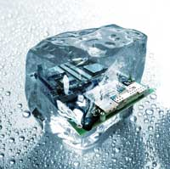
Design pattern Introduction
Hoa Vo
Quan Tran
2015.09.26

Slide 2
Problems
Problems when developing software
Readable
Maintainable
Scalable
Testable
…

Slide 3
OOP concepts
OOP concepts: Abstract class, interface, inheritance, polymorphism … use for ??

Slide 4
Content
What is this

Slide 5
What
Solutions to common problems
Make the code
Reusable
Maintainable
Scalable
Testable

Slide 6
Type
Creational
Behavioral
Structural

Slide 7
Creational
Abstract Factory
Factory Method
Prototype
Builder
Singleton

Slide 8
Structural
Adapter
Composite
Bridge
Decorator
Facade
Flyweight
Proxy

Slide 9
Behavioral
Chain of Resp.
Command
Interpreter
Iterator
Observer
Strategy
…

Slide 10
Practice
DoJo

Slide 11
Structural
Facade
(fəˈsɑːd)

Slide 12
Problem
The system is very complex or difficult to understand
System has a large number of interdependent classes

Slide 13
How
Hides the complexities of the system
Provides an interface to the client using which the client can access the system

Slide 14
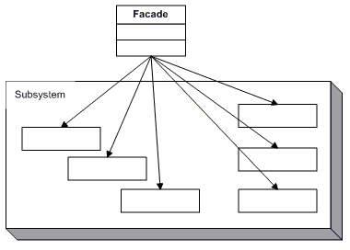
UML

Slide 15
Let code

Slide 16
Behavioral
Observer

Slide 17
When
An object want to notify other objects automatically

Slide 18
How
Calling one of their methods

Slide 19
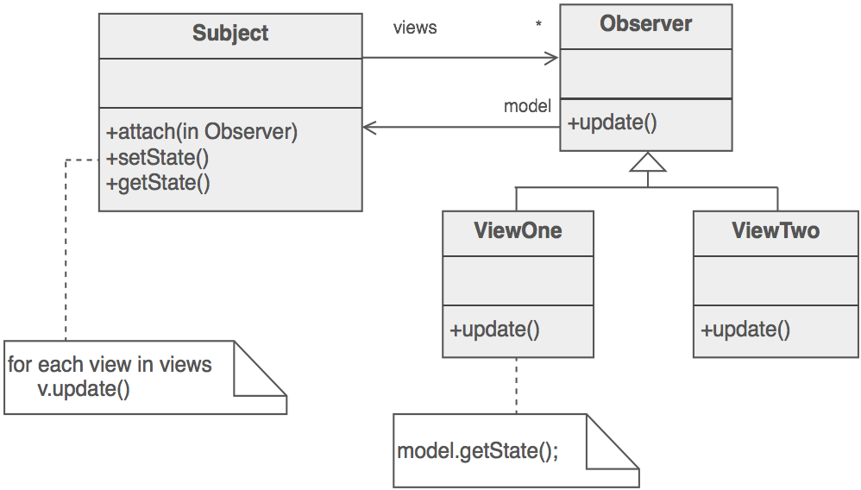
UML

Slide 20
Practice
Let code

Slide 21
Behavioral
Strategy

Slide 22
When
Have a family of implementation
Make them interchangeable

Slide 23
How
Capture the abstraction in an interface
Bury implementation details in derived classes

Slide 24
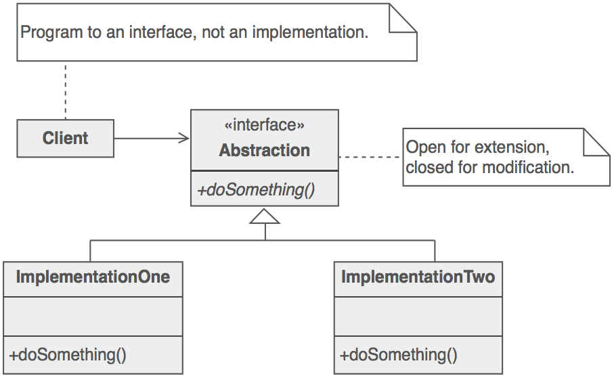
UML

Slide 25
Practice
Let code

Slide 26
Behavioral
Iterator

Slide 27
When
Need a way to access the elements of an aggregate object sequentially

Slide 28
Hide all element inside container
The container provide interface to access element

Slide 29
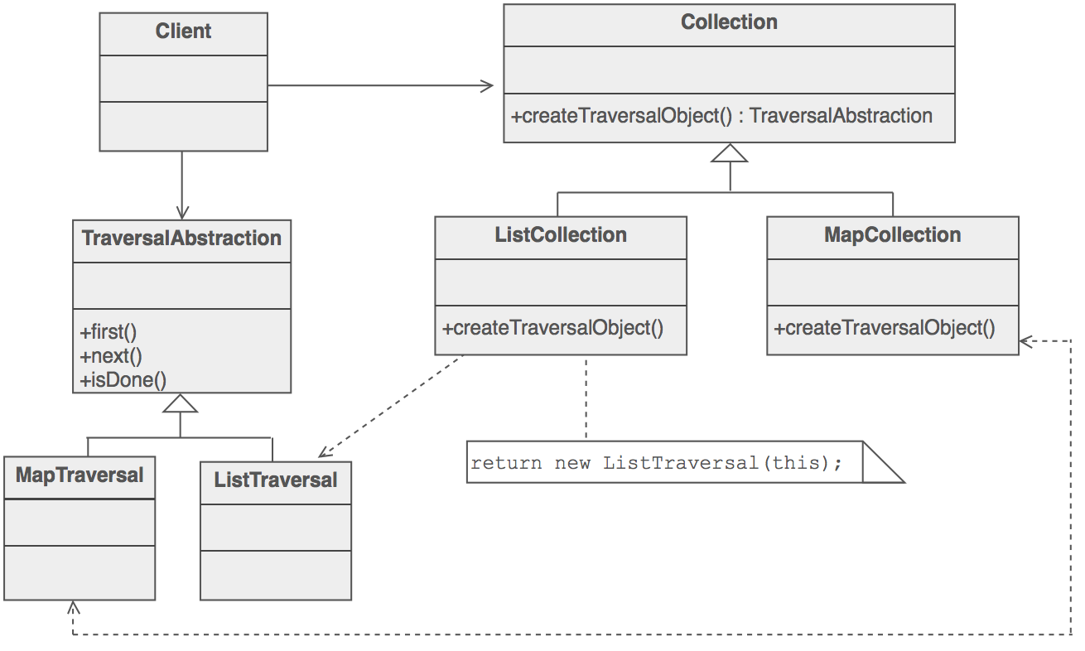
UML

Slide 30

Question & Answer
Any questions ?

Slide 31




Thank for your attention
www.sioux.asia
+84 (0) 5113888756
contact@sioux.asia

